Slide 1
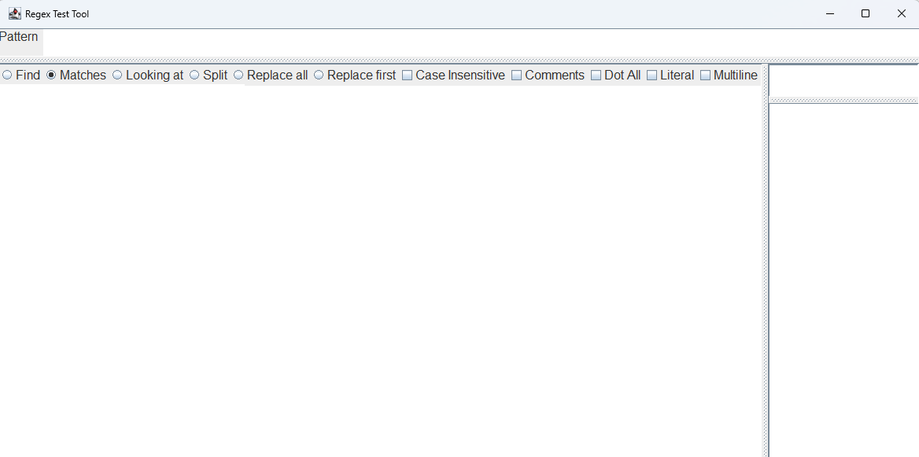
Pattern label
splitPane
topPanel
patternPane
BottomPane
buttonPanel
auxiliarySplit
replacementPane
characterPane
auxiliaryPane

